Slide 1
Chapter Three
Decisions, Relational Operators, logical operators

Slide 2
The if Statement
A computer program often needs to make decisions based on input, or circumstances.
For example, buildings and elevators often skip the 13th floor.
The 14th floor is really the 13th floor
So every floor above 12 is really (floor – 1)
If floor > 12, actual floor = floor - 1
The two keywords of the if statement are:
if
else
The if statement allows a program to carry out different actions depending on the nature of the data to be processed.

Slide 3
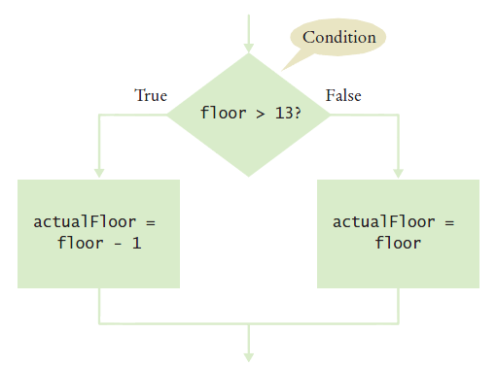
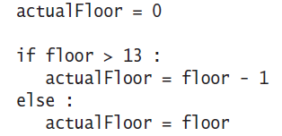
Flowchart of the if Statement
One of the two branches is executed once.
True (if) branch or False (else) branch

Slide 4
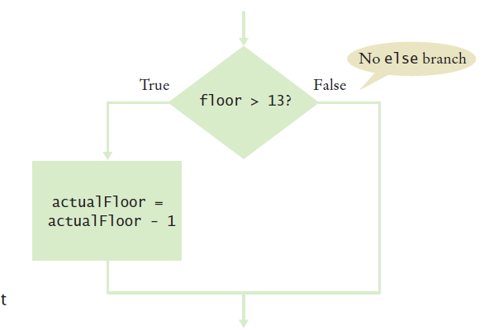
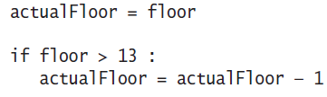
Flowchart with Only a True Branch
An if statement may not need a False (else) branch.
Notes:
The else statement is not needed in the case, since it just actual floor = to the floor.
This is essentially a no op

Slide 5
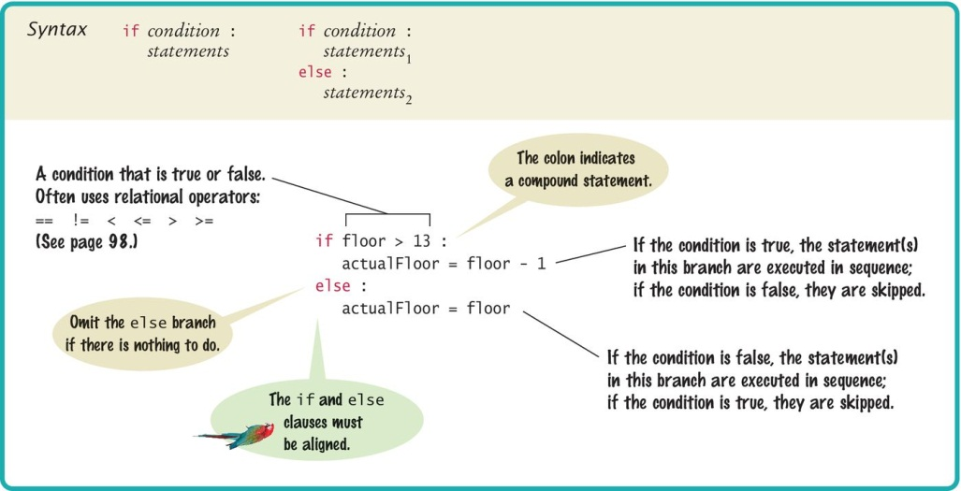
Syntax 3.1: The if Statement

Slide 6
Compound Statements (1)
Some constructs in Python are compound statements.
Compound statements span multiple lines and consist of a header and a statement block.
The if statement is an example of a compound statement.
Compound statements require a colon “:” at the end of the header line.
The statement block is a group of one or more statements, all indented to the same column
The statement block starts on the line after the header and ends at the first statement indented less than the first statement in the block
If you use Wing; Wing properly indents the statement block.
At the end of the block enter a blank line and Wing will shift back to the first column in the current block

Slide 7
Compound Statements (2)
Statement blocks can be nested inside other types of blocks (we will learn about more blocks later).
Statement blocks signal that one or more statements are part of a given compound statement.
In the case of the if construct the statement block specifies:
The instructions that are executed if the condition is true
Or skipped if the condition is false

Slide 8
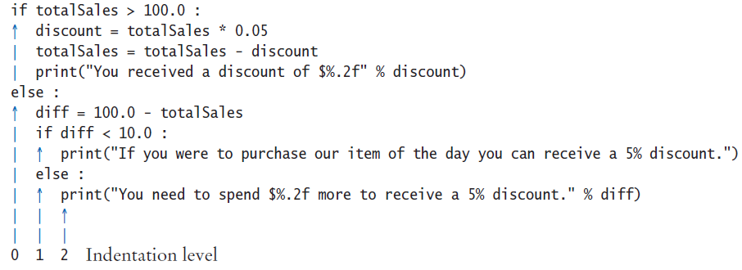
Tips on Indenting Blocks
Let the IDE do the indenting for us …
This is referred to as “block structured” code. Indenting consistently is syntactically required in Python, it also makes code much easier to follow.

Slide 9
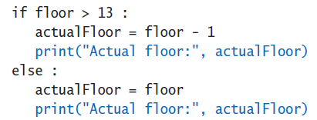
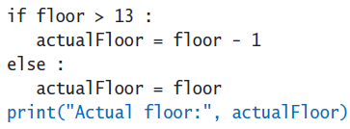
Avoid Duplication in Branches
If the same code is duplicated in each branch, then move it out of the if statement.
is better as:

Slide 10
The Conditional Expression
There are 2 “shortcut” ways to write an if statement when the true block and the false block are one line of code each.
When the if statement has no else clause, it is acceptable practice to write the if statement in one line code:
if num > 0 : print(num, “is positive”)
When the if statement has an else clause, we can also choose to write the if statement in one line of code
This is Python’s way of implementing the ternary operator in other languages.
True branch
Condition
False branch

Slide 11
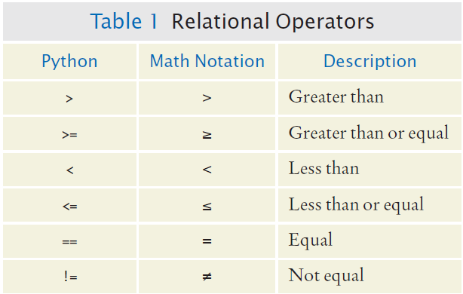
Relational Operators
Every if statement has a condition.
It usually involves comparing two values with an operator
if floor > 13 :
..
if floor >= 13 : ..
if floor < 13 : ..
if floor <= 13 :
..
if floor == 13 : ..

Slide 12
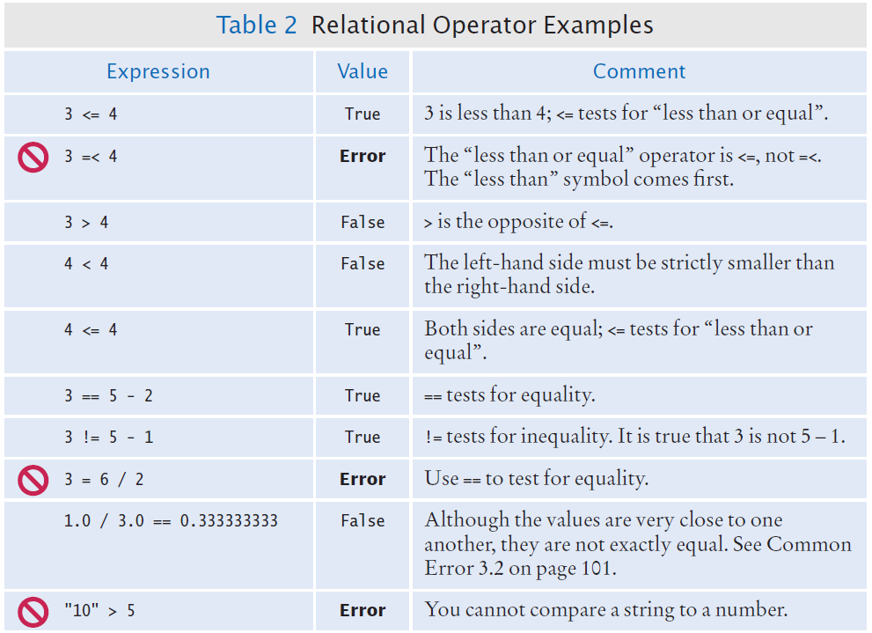
Relational Operator Examples

Slide 13
Operator Precedence
The relational operators have lower precedence than arithmetic operators
Calculations are done before comparisons
Normally our calculations are on the right side of the relational or assignment operator.
Calculations
actualFloor = floor + 1
if floor > height + 1 :

Slide 14
Assignment vs. Equality Testing
Assignment: make something true.
floor = 13
Equality testing: check if something is true.
if floor == 13 :

Slide 15
Comparing Floating Point Numbers
Floating-point numbers have only a limited precision, and calculations can introduce roundoff errors.
We must take these inevitable roundoffs into account when comparing floating point numbers.
For example, the following code multiplies the square root of 2 by itself. Ideally, we expect to get the answer 2:
r = math.sqrt(2.0)
if r * r == 2.0 :
print("sqrt(2.0) squared is 2.0")
else :
print("sqrt(2.0) squared is not 2.0 but", r * r)
Output:
sqrt(2.0) squared is not 2.0 but 2.0000000000000004

Slide 16

The Use of EPSILON
As seen from the example on the previous slide, when comparing 2 floating point numbers for equality, we cannot expect exact values.
Instead, we use a very small value to compare the difference and determine if floating-point values are ‘close enough.’
The magnitude of their difference should be less than some threshold.
Mathematically, we would write that x and y are close enough if:
EPSILON = 1E-14
r = math.sqrt(2.0)
if abs(r * r - 2.0) < EPSILON :
print("sqrt(2.0) squared is approximately 2.0")

Slide 17
Comparing Strings
Checking if two strings are equal
if name1 == name2 :
print("The strings are identical")
Checking if two strings are not equal
if name1 != name2 :
print("The strings are not identical")

Slide 18
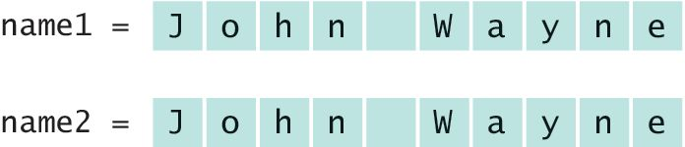
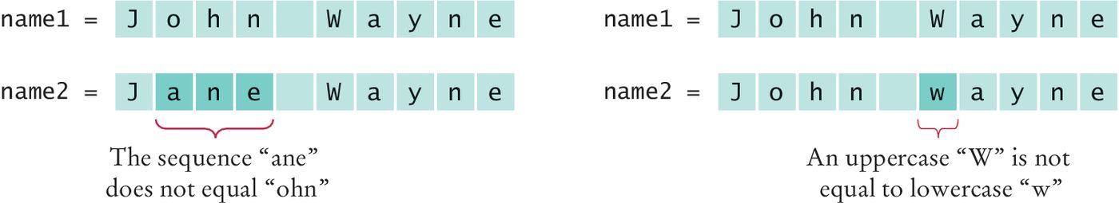
Checking for String Equality
For two strings to be equal, they must be of the same length and contain the same sequence of characters:
If any character is different, the two strings will not be equal:

Slide 19
Lexicographical Order
When we compare strings with relational operators for inequality such as: string1 < string2
we are comparing strings in ‘dictionary’ like order, or more precisely in ASCII order.
ASCII order:
All UPPERCASE letters come before lowercase
‘space’ comes before all other printable characters
Digits (0-9) come before all letters
See Appendix A for the Basic Latin (ASCII) Subset of Unicode

Slide 20
Comparing for Equality: == vs is
There are 2 ways to compare for equality between 2 variables:
Using == to check whether the 2 variables have the same value
Using is to test whether the 2 variable names are references to the same memory location (same object)
Example:
In general, use == to compare for equality because the majority of the time we want to compare data values We use is to check when a variable has no data value: if var1 is None
A variable with a value None means it contains no data.
var1 = 1000
var2 = 1000
var1 == var2 # returns True, both var1’s and var2’s # values are 1000
var1 is var2 # returns False, var1 references a # different memory location than var2

Slide 21
Nested Branches
We can nest an if inside either true or false branch of another if statement.
Simple example: Ordering drinks
Ask the customer for their drink order
if customer orders wine
Ask customer for ID
if customer’s age is 21 or over
Serve wine
else
Politely explain the law to the customer
else
Serve customers a non-alcoholic drink

Slide 22
Multiple Alternatives

Slide 23
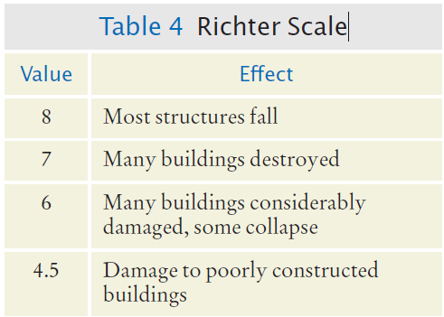
Multiple Alternatives
What if we have more than two branches?
Count the branches for the following earthquake effect example:
8 (or greater)
7 to 7.99
6 to 6.99
4.5 to 5.99
Less than 4.5
When using multiple if statements, test the general conditions after the more specific conditions.

Slide 24
Flowchart of Multiway Branching
True
>= 8.0?
Most Structures Fall
False
>= 7.0?
True
Many Buildings Destroyed
False
>= 6.0?
True
Many buildings considerably damaged, some collapse
False
>= 4.5?
True
Damage to poorly constructed buildings
False
No destruction of buildings

Slide 25
elif Statement
Short for: else if
As soon as one of the test conditions evaluates to True:
The corresponding True block is executed
No other tests will be attempted
If none of the test conditions succeed, then the final else clause is executed.

Slide 26
if, elif Multiway Branching
if richter >= 8.0 : # Handle the ‘special cases’ first
print("Most structures fall")
elif richter >= 7.0 :
print("Many buildings destroyed")
elif richter >= 6.0 :
print("Many buildings damaged, some collapse")
elif richter >= 4.5 :
print("Damage to poorly constructed buildings")
else : # so that the ‘general case’ can be handled last
print("No destruction of buildings")

Slide 27
What is Wrong With This Code?
if richter >= 8.0 :
print("Most structures fall")
if richter >= 7.0 :
print("Many buildings destroyed")
if richter >= 6.0 :
print("Many buildings damaged, some collapse")
if richter >= 4.5 :
print("Damage to poorly constructed buildings")

Slide 28
Using Flowcharts to Develop and Refine Algorithms

Slide 29
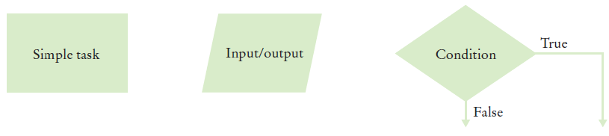
Problem Solving: Flowcharts
You have seen a few basic flowcharts
A flowchart shows the structure of decisions and tasks to solve a problem
Basic flowchart elements:
Connect them with arrows
But never point an arrow inside another branch!
Each branch of a decision can contain tasks and further decisions

Slide 30
Using Flowcharts
Flowcharts are an excellent tool to help us visualize the flow of the algorithm.
Building the flowchart:
Link the tasks and input / output boxes in the sequence they need to be executed.
When the code needs to make a decision, use the diamond (a conditional statement) with two outcomes.
Never point an arrow inside another branch.

Slide 31
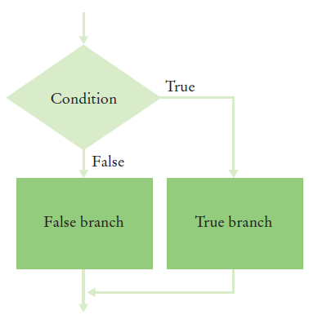
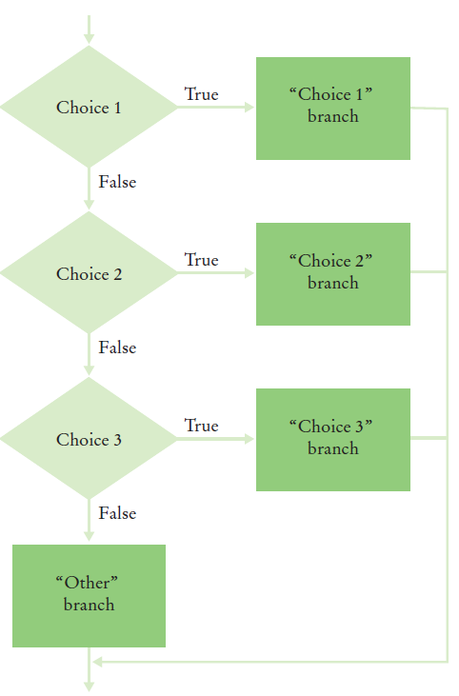
Conditional Flowcharts
Two Outcomes
Multiple Outcomes

Slide 32
Boolean Variables and Operators

Slide 33
Boolean Variables and Operators
Boolean Variables
A Boolean variable is often called a flag because it can be either set (true) or not set (false).
Boolean values are either True or False
The data type for True or False is bool
Boolean Operators
There are 3 Boolean Operators: and, or, not
and, or are used to combine multiple conditions
not is used to reverse the boolean value of an expression

Slide 34
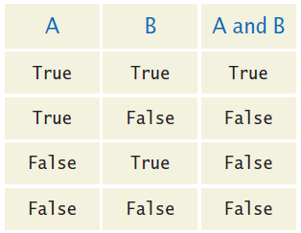
Combined Conditions: and
Combining two conditions is often used in range checking
Is a value between two other values?
Both sides of the and must be true for the result to be true
It is also possible to write:
if temp > 0 and temp < 100 :
print("Liquid")
if 0 < temp < 100 :
print("Liquid")

Slide 35
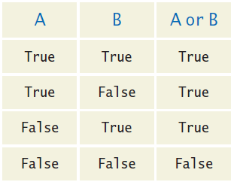
Combined Conditions: or
We use or if only one of two conditions need to be true
Use a compound conditional with an or:
If either condition is true, the result is true.
if temp <= 0 or temp >= 100 :
print("Not liquid")

Slide 36
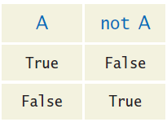
The not operator: not
To invert the logic of a boolean variable or expression, precede it with not
Instead of using not, we can often simplify the code by reversing the logic of the condition:
if not attending or grade < 60 :
print("Drop?")
if attending and not(grade < 60) :
print("Stay")
if attending and grade >= 60 :
print("Stay")

Slide 37
The not operator: inequality !
A slightly different operator is used for the not when checking for inequality rather than negation.
Example inequality:
The password that the user entered is not equal to the password on file.
if userPassword != filePassword :

Slide 38
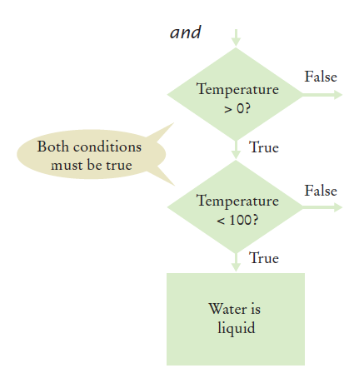
Flowchart for the and operator
This is often called ‘range checking’
Used to validate that the input is between two values
if temp > 0 and temp < 100 :
print("Liquid")

Slide 39
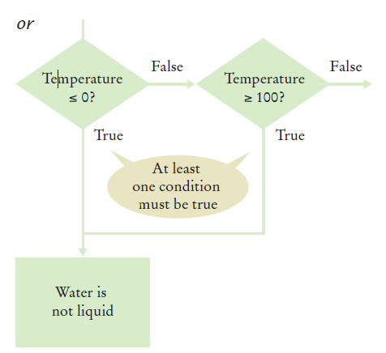
Flowchart for the or operator
Another form of ‘range checking’
Checks if value is outside a range
if temp <= 0 or temp >= 100 :
print("Not Liquid")

Slide 40
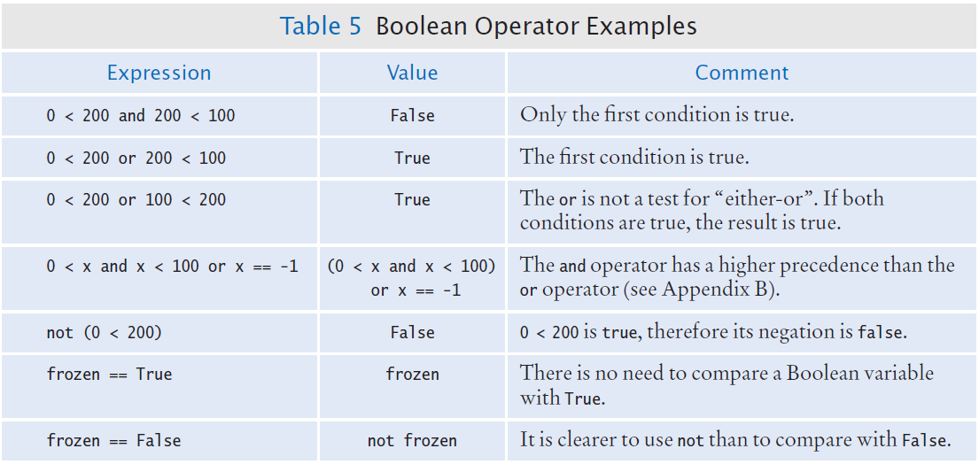
Boolean Operator Examples

Slide 41
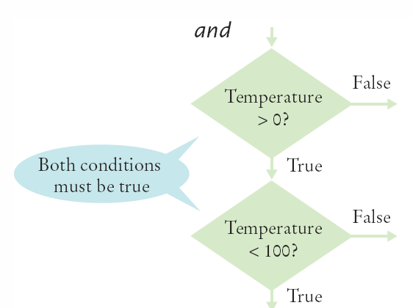
Short-circuit Evaluation: and
Combined conditions are evaluated from left to right
If the left half of an and condition is false, there is no need to evaluate the right half
if temp > 0 and temp < 100 :
print("Liquid")
Done!

Slide 42
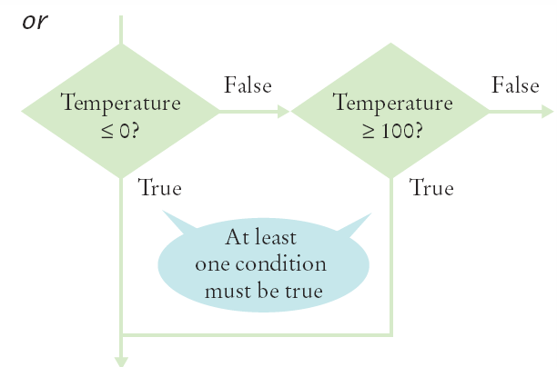
Short-circuit evaluation: or
If the left half of the or is true, there is no need to evaluate the right half.
if temp <= 0 or temp >= 100 :
print("Not Liquid")
Done!

Slide 43
De Morgan’s law
De Morgan’s law tells us how to negate and and or conditions:
not(A and B) is the same as notA or notB
not(A or B) is the same as notA and notB
Example: Shipping is higher to AK and HI
To simplify conditions with negations of and or or expressions, it’s a good idea to apply De Morgan’s law to move the negations to the innermost level.
if (country != "USA"
and state != "AK"
and state != "HI") :
shippingCharge = 20.00
if not(country=="USA"
or state=="AK"
or state=="HI") : shippingCharge = 20.00

Slide 44
Analyzing Strings

Slide 45
The in Operator
Sometimes it’s necessary to analyze or ask certain questions about a particular string.
Example: determine if a string contains a given substring. That is, one string contains an exact match of another string.
Given the code segment: name = "John Wayne"
The expression: "Way" in name
evaluates to True because the substring "Way" occurs within the string stored in the variable name.
The not in operator is the inverse on the in operator

Slide 46
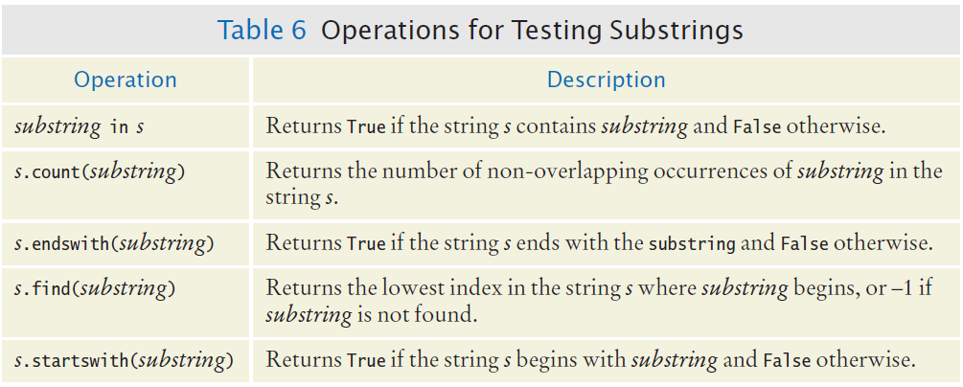
Methods for Testing Substrings

Slide 47
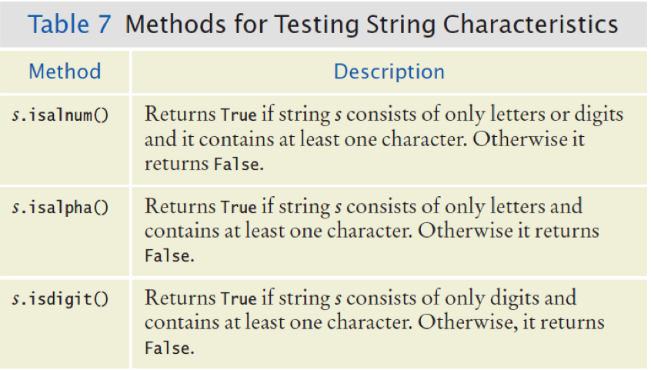
Methods for Testing Characters (1)
Notes:
Is alphanumeric
Is alphabetic

Slide 48
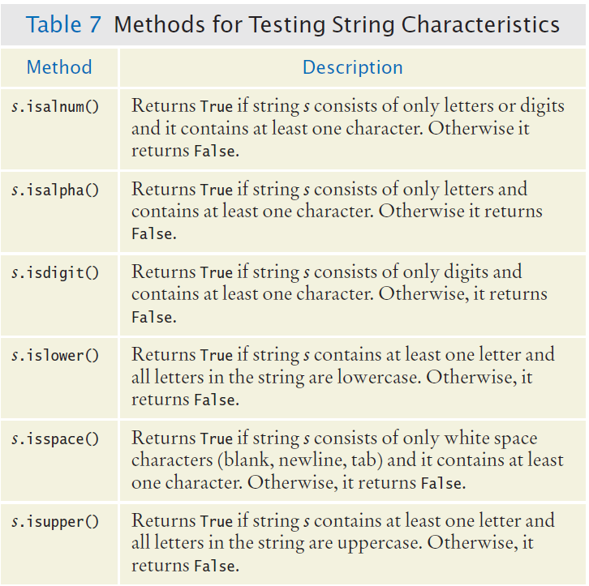
Methods for Testing Characters (2)

Slide 49
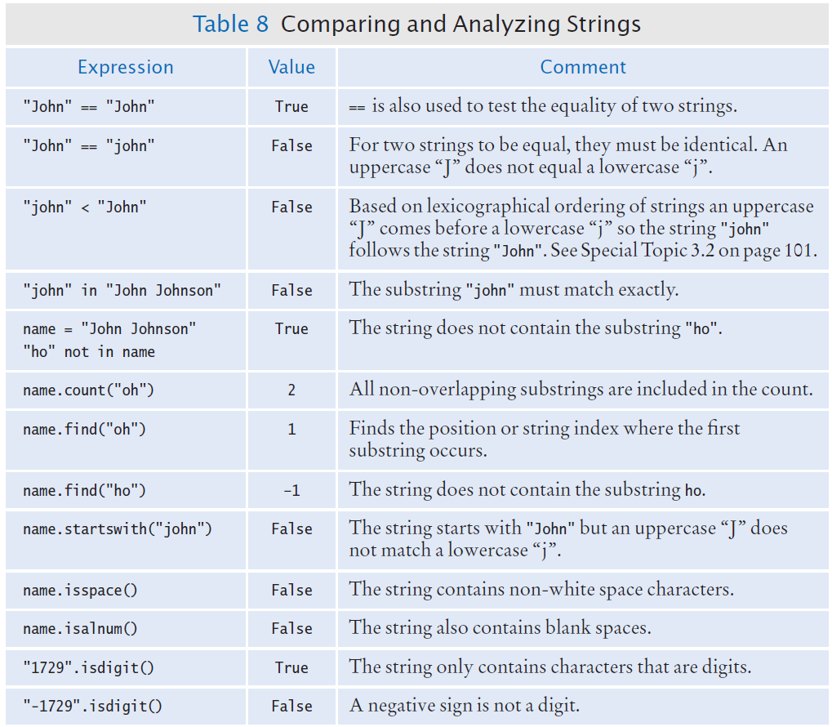
Examples of Analyzing Strings

Slide 50
End of Chapter 3 Notes

